Slide 1
Fundamentals of data representation

Slide 2
ILO’s
Understand that computers use binary to represent data and instructions.
Be able to convert between binary and decimal and vice-versa.

Slide 3
Binary – the B all and end all
Computers use binary to store information
Imagine explaining everything that you know in 0 and 1!

Slide 4
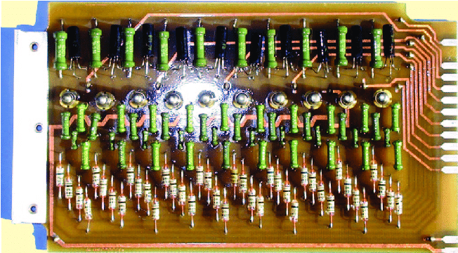
Back where it began:
Computers are made of transistors that switch between either high or low voltage
The processor reads the voltage of the transistor

Slide 5
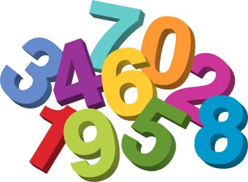
Number

Slide 6
Decimal notation vs binary notation
Each number in decimal notation is the equivalent times by ten to the power of it’s position
8
4
84
=
6
5
4
3
2
1
0
8x10¹
+ 4x10⁰

Slide 7
Decimal notation vs binary notation
Each number in binary notation is the equivalent times by 2 to the power of it’s position
1
0
1
0
1
0
0
84
=
6
5
4
3
2
1
0
1x2⁶
+ 1x2⁴
+ 1x2²

Slide 8
Exercises
https://learningnetwork.cisco.com/s/binary-game
Convert the numbers the following numbers to decimal:
01001110
10010010
11110000
Convert the following numbers to binary
84
64
32
255

Slide 9
Answers
https://learningnetwork.cisco.com/s/binary-game
Convert the numbers the following numbers to decimal:
01001110 = 78
10010010 = 146
11110000 = 240
Convert the following numbers to binary
84 = 1010100
64 = 1000000
32 = 0100000
255 = 11111111

Slide 10
ILO’s
Understand that computers use binary to represent data and instructions.
Be able to convert between binary and decimal and vice-versa.

Slide 11
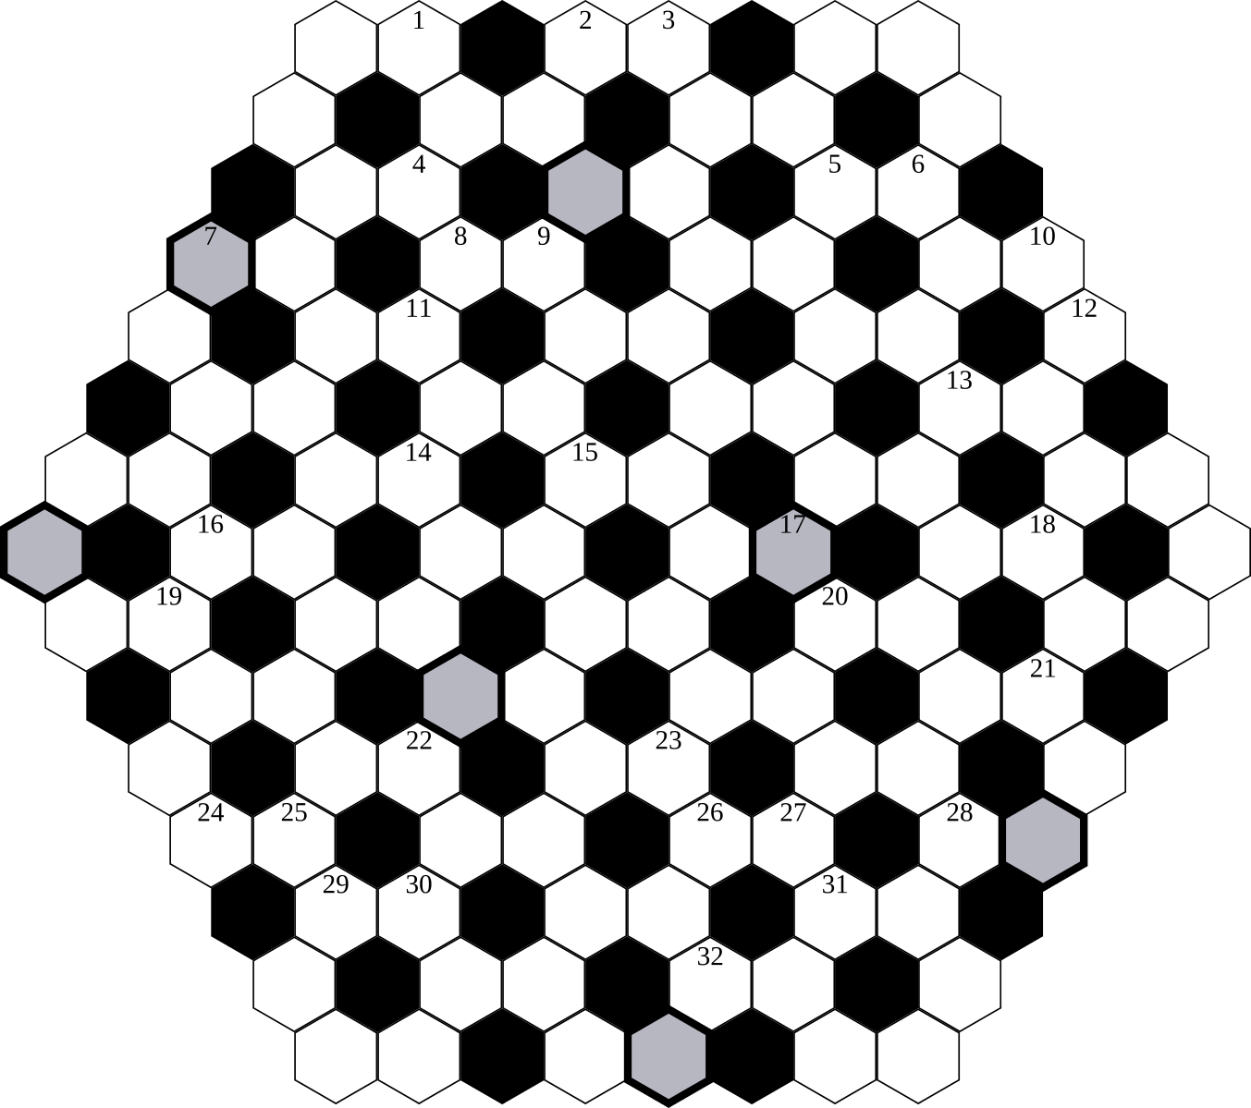
Hexadecimal

Slide 12
ILO’s
Be able to convert between decimal and hexadecimal as well as binary and hexadecimal.
Understand why hexadecimal is often used in computer science and give examples of where it is used.

Slide 13
What the HEX!?
Larger numbering system
More similar to decimal numbers

Slide 14
Hexadecimal notation
Each number in hexadecimal notation is the equivalent times by sixteen to the power of it’s position. The numbers expand past 9 and spill into letters (A, B, C, D, E and F)
8
4
132
=
6
5
4
3
2
1
0
8x16¹
+ 4x16⁰

Slide 15
Hexadecimal notation
A=10, B=11, C=12, D=13, E=14, F=15
A
B
171
=
6
5
4
3
2
1
0
Ax16¹ = 10 x 16
+ Bx16⁰ = 11 x 1

Slide 16
Exercises
What would these hex numbers be in decimal?
11
2B
FA

Slide 17
Answers
What would these hex numbers be in decimal?
11 - 17
2B - 43
FA - 250

Slide 18
Why and where do we use hexadecimal?
Large numbers a represented in a few digits
Used in MAC address and colour values
Easier to remember than binary because there are fewer digits
BE0000
00D900
AF00F0

Slide 19
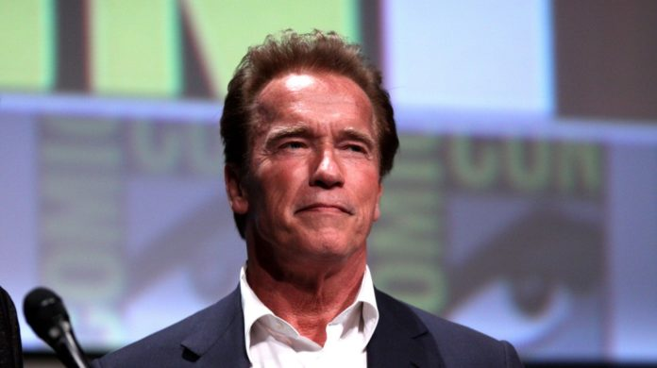
https://www.youtube.com/watch?v=Iey7_N_mEx4
https://www.youtube.com/watch?v=DXpyqHH-52c

Slide 20
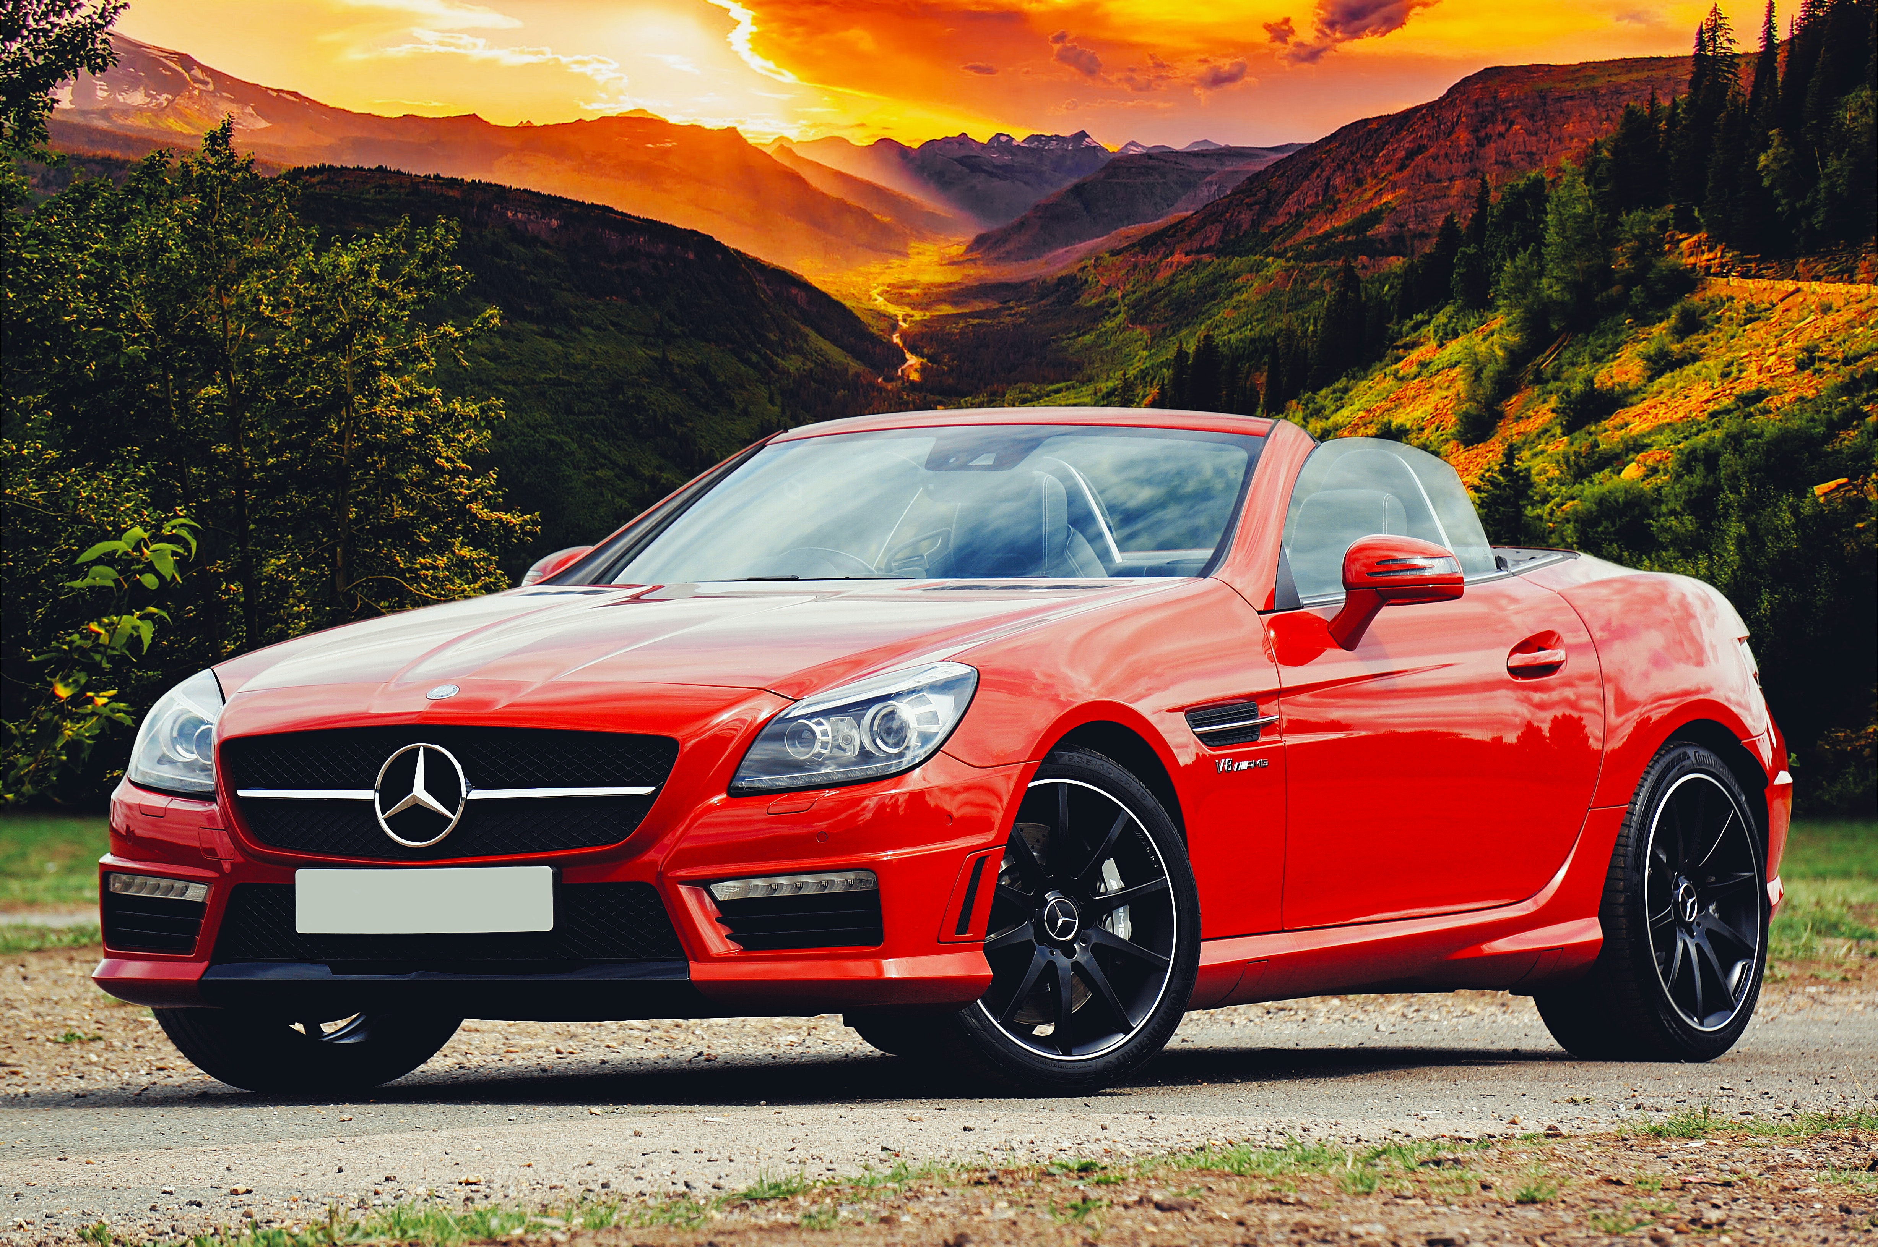
How do we convert between them all?
Decimal to hexadecimal
If number is larger than 16:
Divide number by 16
Take hex value of equivalent remainder

Slide 21
How do we convert between them all?
Decimal to hexadecimal
If number is larger than 16:
Divide number by 16
Take hex value of equivalent remainder
Example: 22
16 goes into 22 once = 1 = hex 1
Remainder = 6 = hex 6
Result: 16
1x16¹ + 6x16⁰

Slide 22
Exercises
What would these decimal numbers be in hexadecimal?
138
8
2748

Slide 23

Answers
What would these decimal numbers be in hexadecimal?
138 = 8A
8 = 8
2748 = ABC

Slide 24
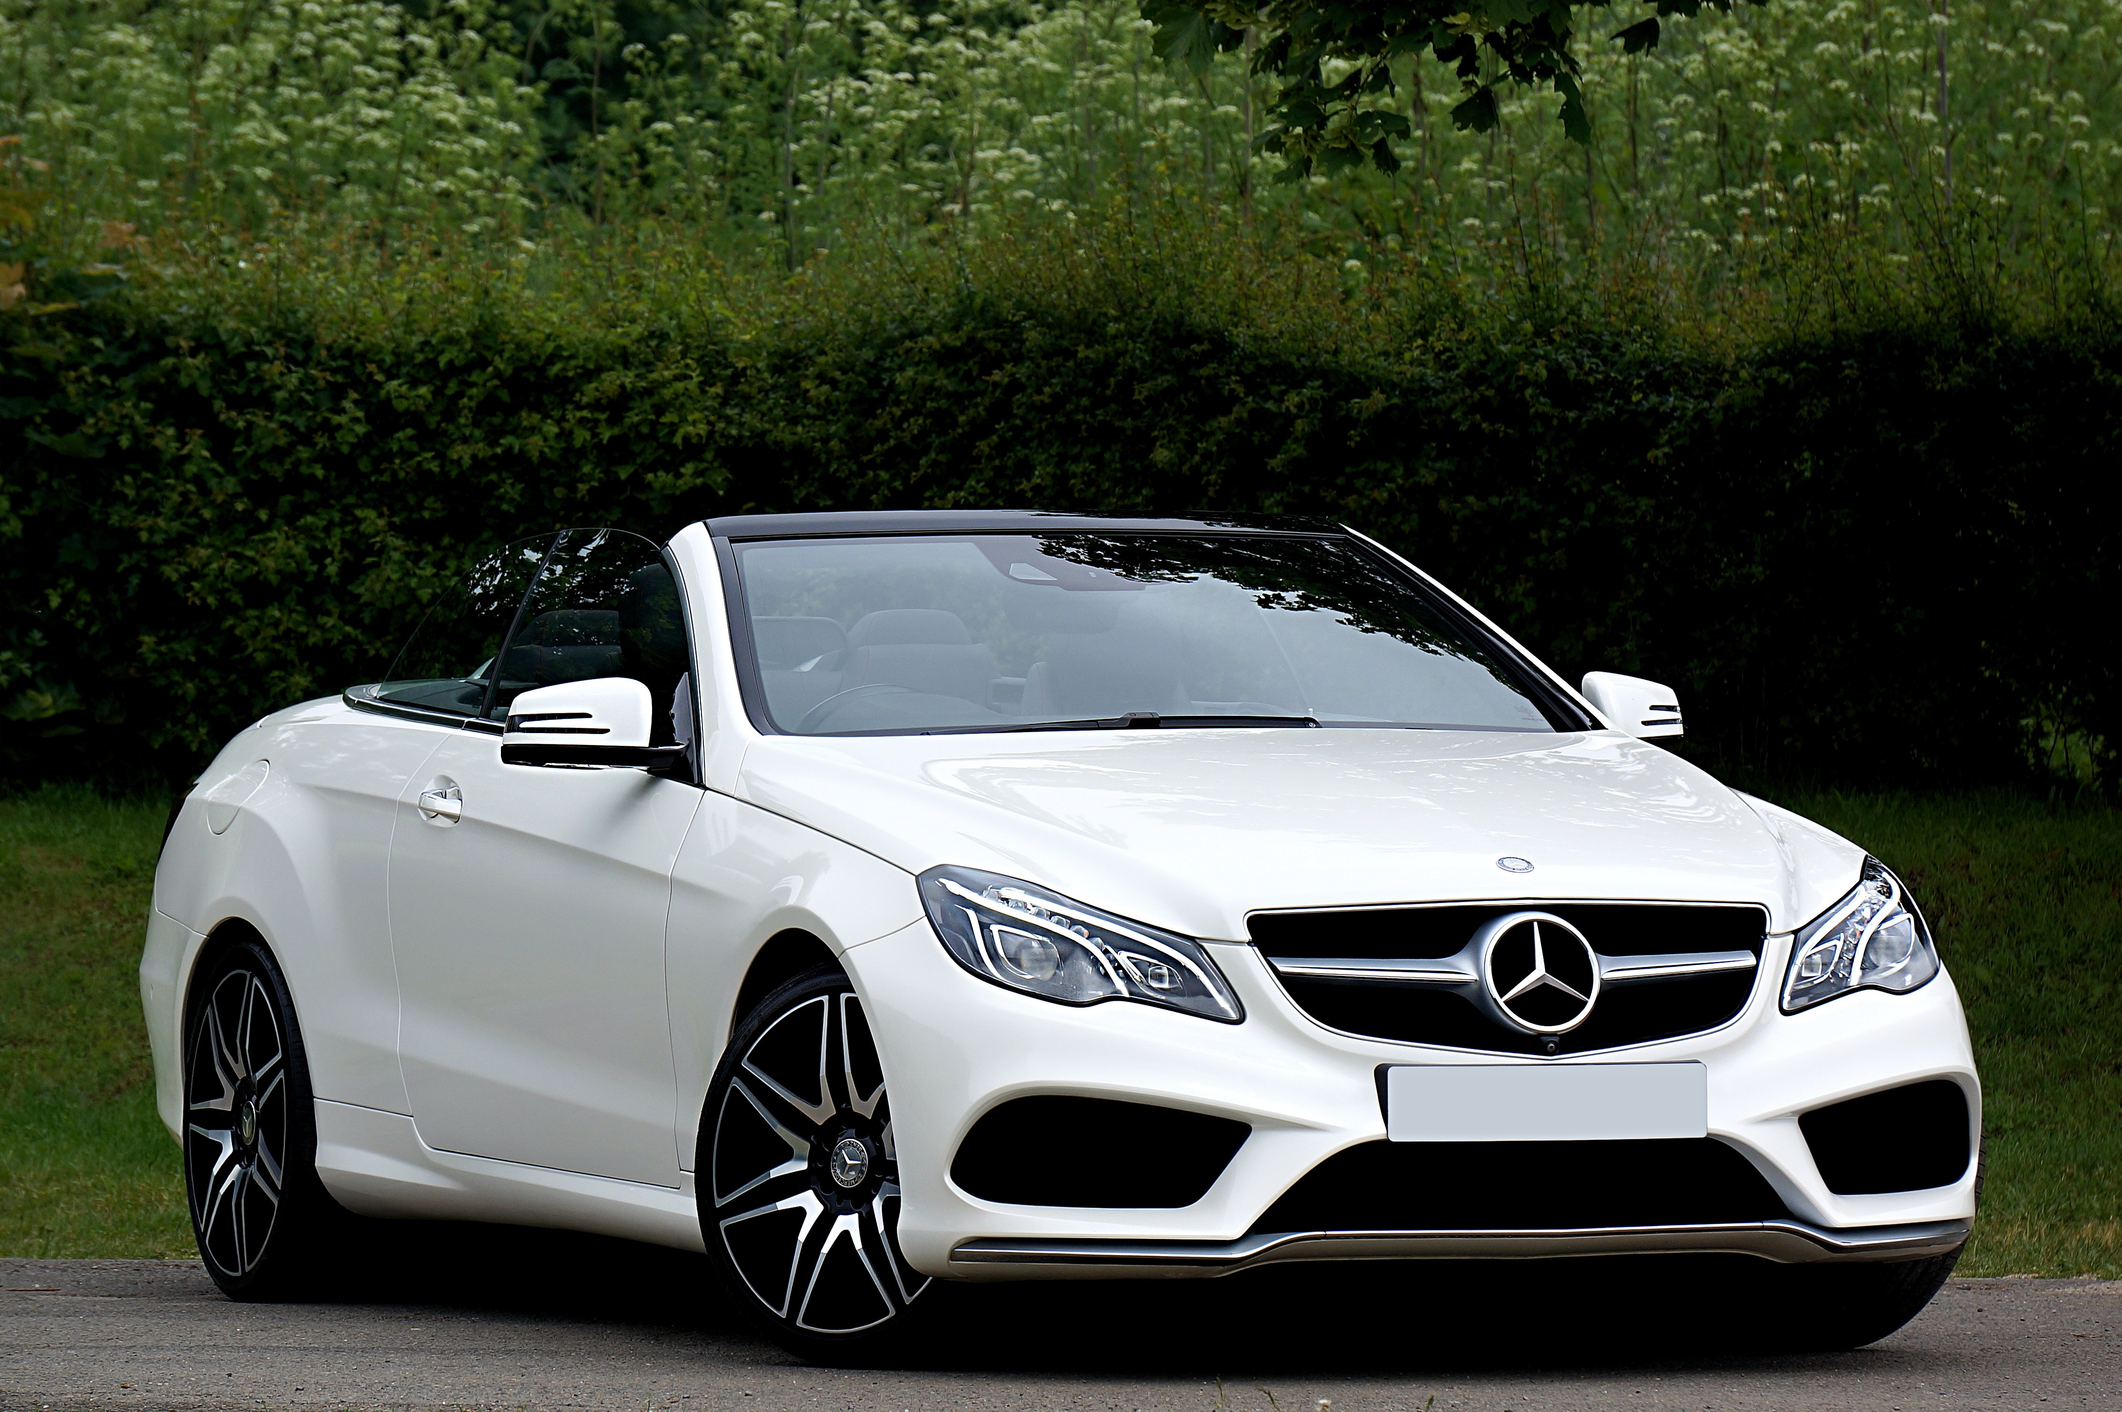
How do we convert between them all? Part 2
Binary to hexadecimal
Starting from the right, break up into groups of 4
Convert each group into decimal
Convert each decimal to hex
Put the hex digits together

Slide 25
How do we convert between them all? Part 2
Binary to hexadecimal
Starting from the right, break up into groups of 4
Convert each group into decimal
Convert each decimal to hex
Put the hex digits together
Example: 11000011
1100 0011
1100 = 12 0011 = 3
12 = hex C 3 = hex 3
Result = C3

Slide 26
Exercises
What would these binary numbers be in hexadecimal?
1101
11011101
100100110

Slide 27
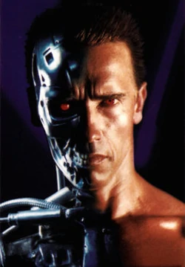
Answers
What would these binary numbers be in hexadecimal?
1101 - D
11011101 – DD
100100110 - 146
0010 0110
1 4 4+2(6)
146

Slide 28
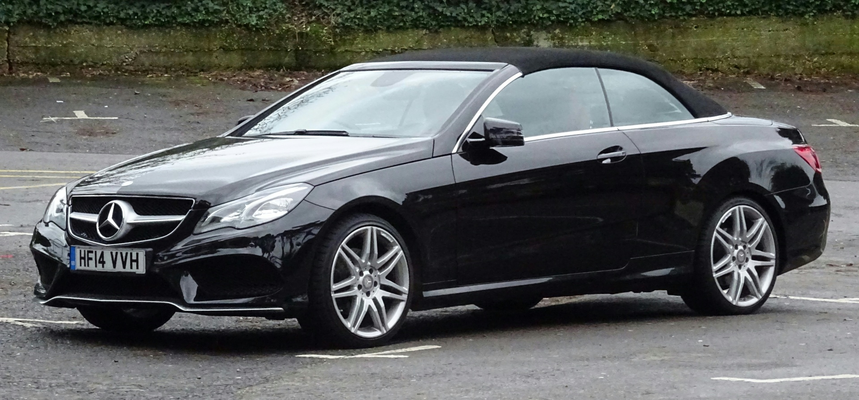
How do we convert between them all? Part 3
Hexadecimal to binary
Split hex into individual digits
Convert each hex to decimal
Convert each decimal to binary
Put the binary digits together

Slide 29
How do we convert between them all? Part 3
Hexadecimal to binary
Split hex into individual digits
Convert each hex to decimal
Convert each decimal to binary
Put the binary digits together
Example: 28
2 8
2 = 0010 8 =1000
Result = 00101000

Slide 30
Exercises
What would these hex numbers be in binary?
11
2B
AA

Slide 31
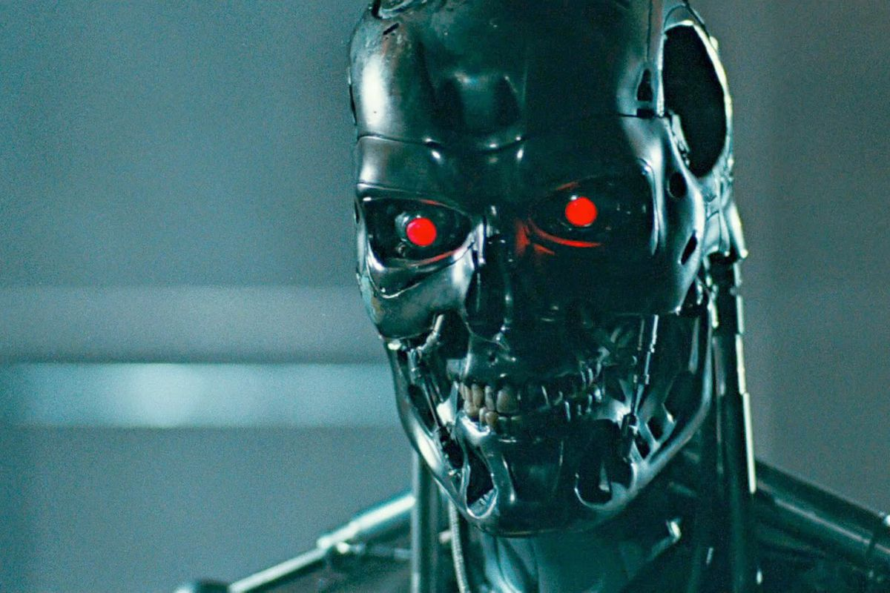
Answers
What would these hex numbers be in binary?
11 - 00010001
2B - 00101011
AA - 10101010

Slide 32
The ultimate converting machine!
“I need your clothes, your boots and your binaries”
https://www.youtube.com/watch?v=lYOoWCv_PYE

Slide 33
ILO’s
Be able to convert between decimal and hexadecimal as well as binary and hexadecimal.
Understand why hexadecimal is often used in computer science and give examples of where it is used.

Slide 34
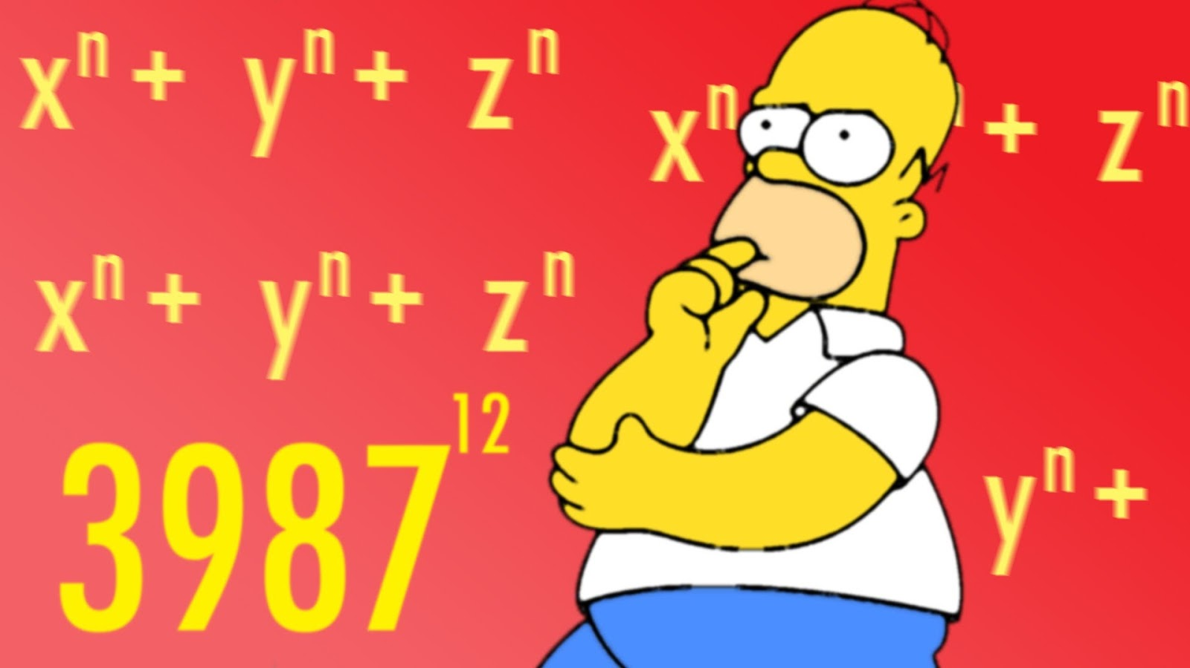
Math with Bits

Slide 35
ILO’s
Be able to add together three binary numbers.
Be able to perform logical shifts.

Slide 36
Adding binaries
The rules:
0 + 0 = 0
1 + 0 = 1
0 + 1 = 1
1 + 1 = 10
We work one column at a time and 2 digits at a time

Slide 37
Adding binaries
1 0
1 0 1
+

Slide 38
Adding binaries
1 0
1 0 1
+
1 0 1 1

Slide 39
Adding binaries
0 1 0 1
1 1 1 0 1
+

Slide 40
Adding binaries
0 1 0 1
1 1 1 0 1
+
1 1 0 0 1 0

Slide 41
Adding binaries
0 1 0 1
1 1 1 0 1
1 0 0 1 1
+
+

Slide 42
Adding binaries
0 1 0 1
1 1 1 0 1
1 0 0 1 1
+
+
1 0 0 0 1 0 1

Slide 43

Exercises
Add the following binary numbers:
10001 + 11101
10111 + 110001
10001 + 11101 + 10111
11010 + 00010 + 1101

Slide 44
Answers
Add the following binary numbers:
10001 + 11101 = 101110
10111 + 110001 = 1001000
10001 + 11101 + 10111 =?
11010 + 00010 + 1101 = ?
https://www.youtube.com/watch?v=0Whn0YzNG4s

Slide 45
Multiplying binaries
Also known as binary/logical shift
Each time we shift a binary number to the left we multiply it by 2^{shift}
For example:
0101 binary shift to the left = 01010
0101 in decimal = 1x2⁰ + 1x2² = 5
01010 in decimal = 1x2¹ + 1x2³ = 10
5 x 2¹ =10

Slide 46
Multiplying binaries
How would we divide?
SHIFT TO THE RIGHT!

Slide 47
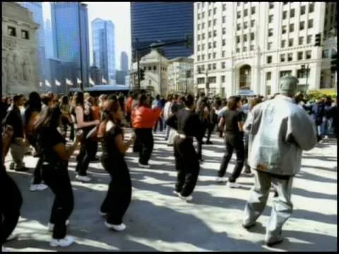
Exercises
Convert 26 to binary
Multiply this binary number by 8
What is the new binary number?
What is it in decimal?
What happens if you divide it by 4

Slide 48
Answers
Convert 26 to binary
00011010
Multiply this binary number by 8
00011010000
What is the new binary number?
What is it in decimal?
208
What happens if you divide it by 4
000110100

Slide 49
ILO’s
Be able to add together three binary numbers.
Be able to perform logical shifts.

Slide 50
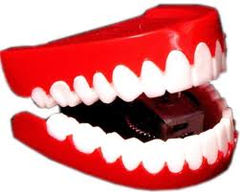
Bytes

Slide 51
ILO’s
Students know the units bit, byte, kilobyte, megabyte, gigabyte and terabyte.
Students know the names, symbols and corresponding values for decimal prefixes and are able to compare quantities.

Slide 52
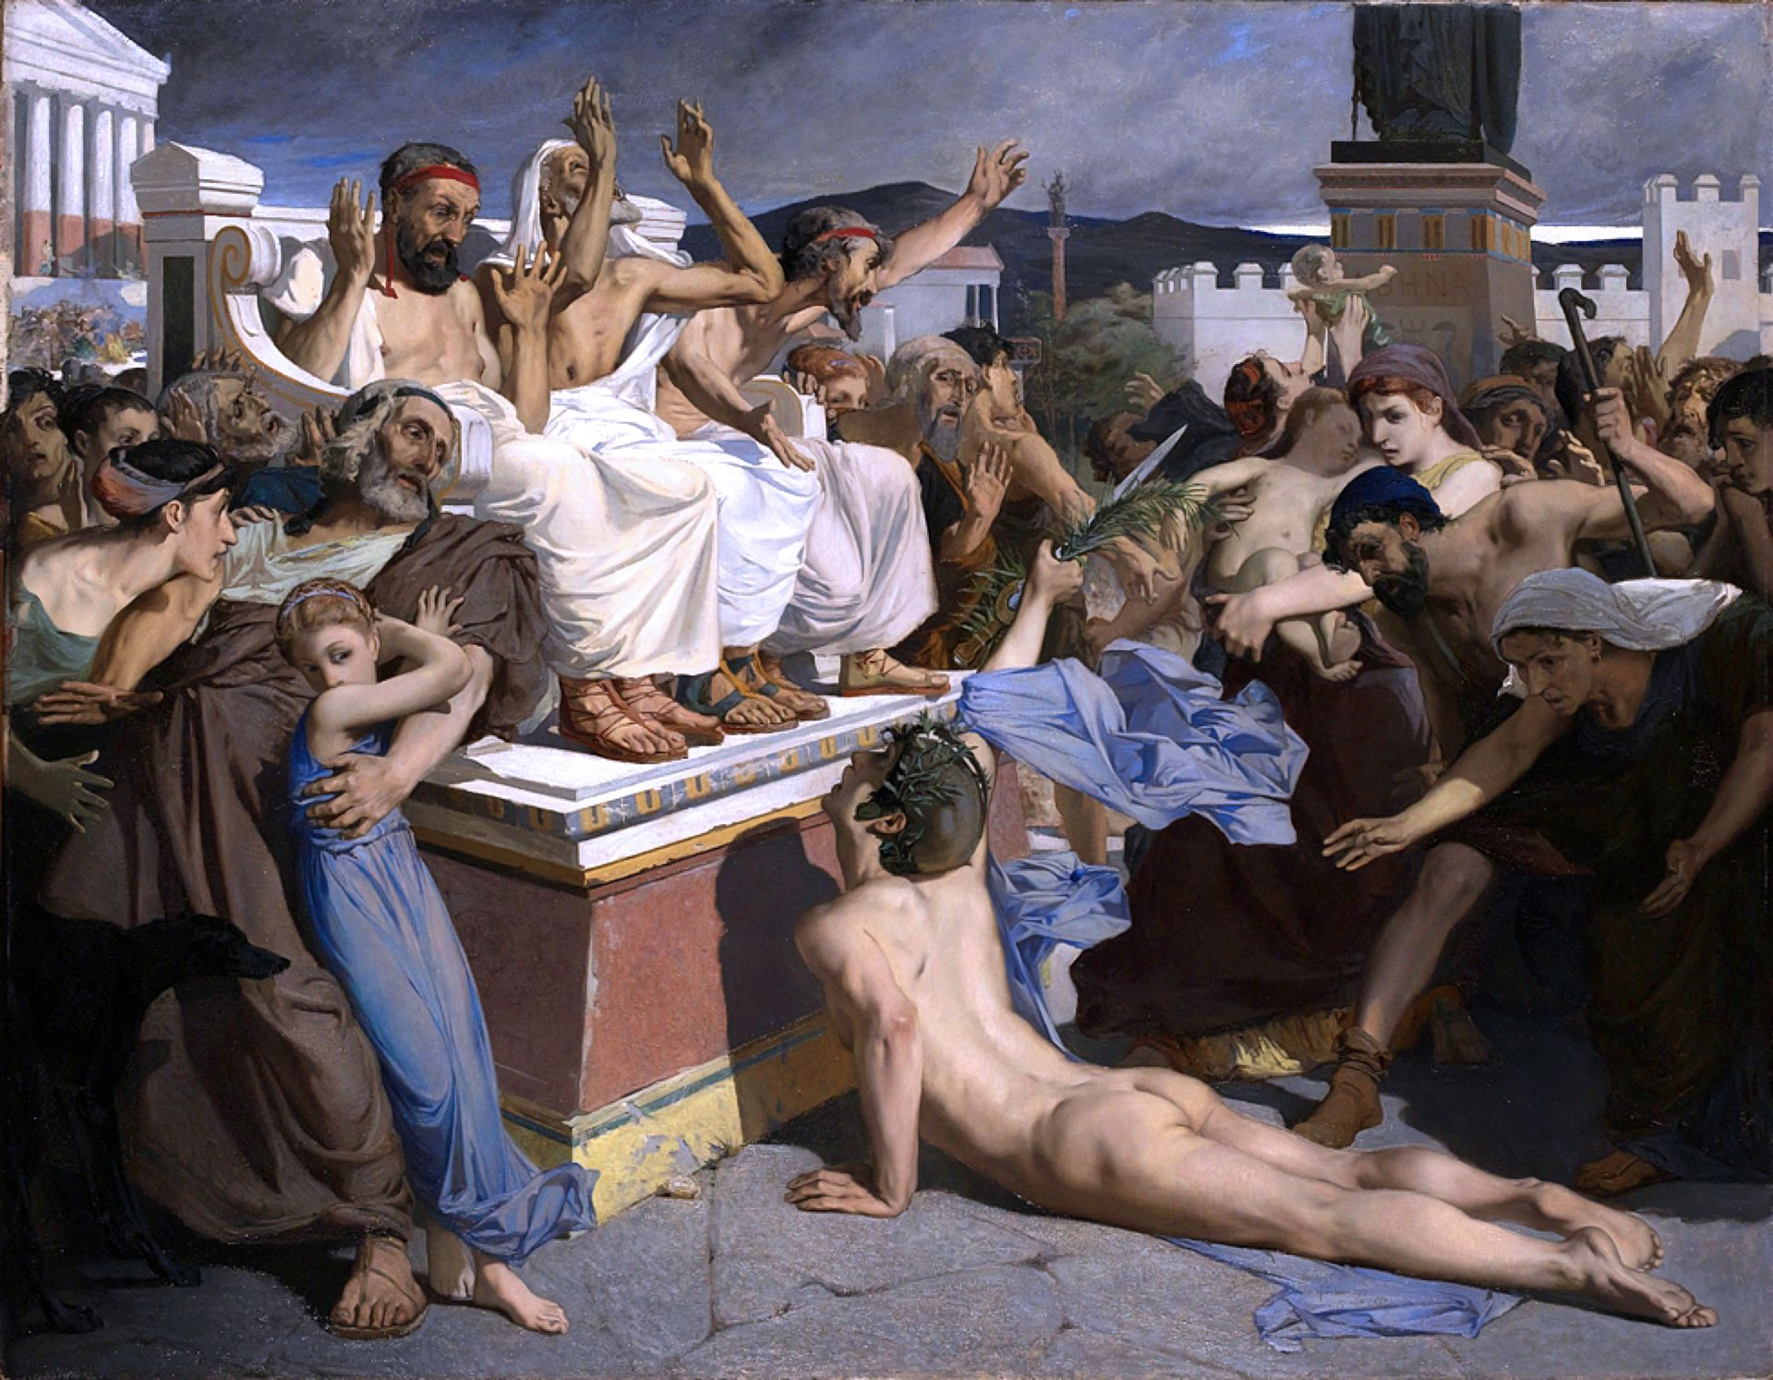
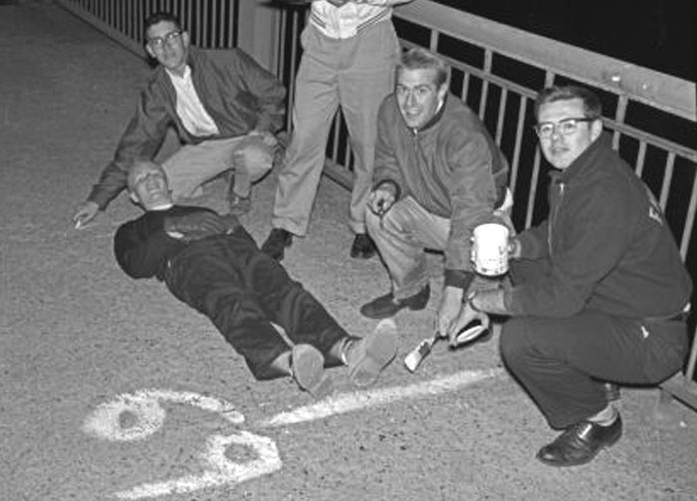
Bits and bytes
We have recently seen bits before, the single unit of an 8-bit binary
Therefore a bit is simply either a 0 or a 1
A byte is 8 of these!
These then go up in powers of 10…
A kilobyte (kB) = 1000 bytes
A megabyte (MB) = 1000 kilobytes
A gigabyte (GB) = 1000 megabytes
A terabyte (TB) = 1000 gigabytes

Slide 53
Exercises
Look up the memory sizes of different objects, try your phone, laptop, RAM, download limits, phone data contracts etc.
What is larger, 3,000 Megabytes or 4 Gigabytes?
Convert 9.1 GB to MB
Convert 1 TB to GB
Convert 15 GB to TB
Convert 10kB to GB
Convert 327 MB to TB

Slide 54
Answers
Look up the memory sizes of different objects, try your phone, laptop, RAM, download limits, phone data contracts etc.
What is larger, 3,000 Megabytes or 4 Gigabytes? 4 GB
Convert 9.1 GB to MB = 9100
Convert 1 TB to GB = 1000
Convert 15 GB to TB = 0.015 TB
Convert 10kB to GB = 0.00001 GB
Convert 327 MB to TB =0.000327 TB

Slide 55
ILO’s
Students know the units bit, byte, kilobyte, megabyte, gigabyte and terabyte.
Students know the names, symbols and corresponding values for decimal prefixes and are able to compare quantities.

Slide 56
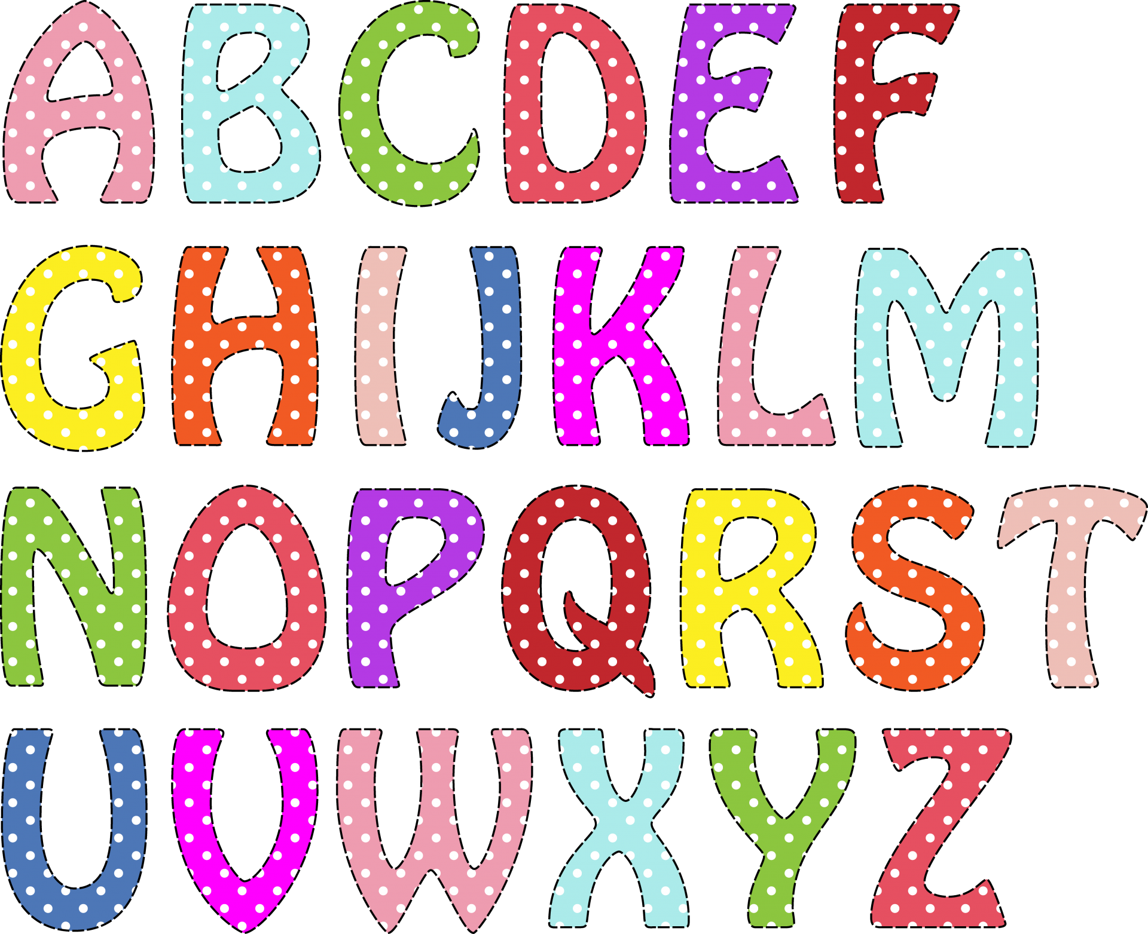
Text

Slide 57
ILO’s
Understand character sets including ASCII and Unicode and the advantages of Unicode.
Be able to use a character table to convert a message from binary to a character set and vice-versa.

Slide 58
Multiplying binaries
Also known as binary/logical shift
Each time we shift a binary number to the left we multiply it by 2^{shift}
For example:
0101 binary shift to the left = 01010
0101 in decimal = 1x2⁰ + 1x2² = 5
01010 in decimal = 1x2¹ + 1x2³ = 10
5 x 2¹ =10

Slide 59
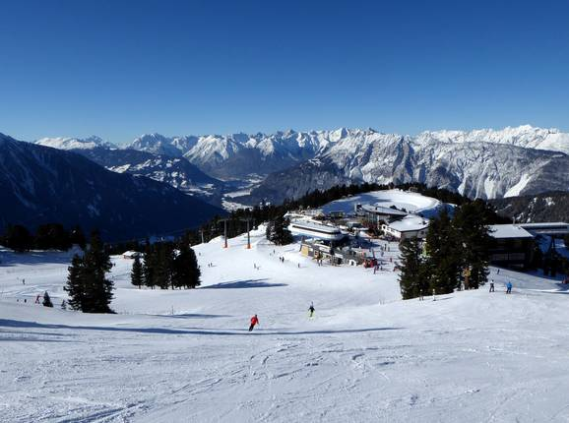

ASCII vs Uni -code
How do we communicate with computers using text?
We assign numbers to symbols using a “code”

Slide 60
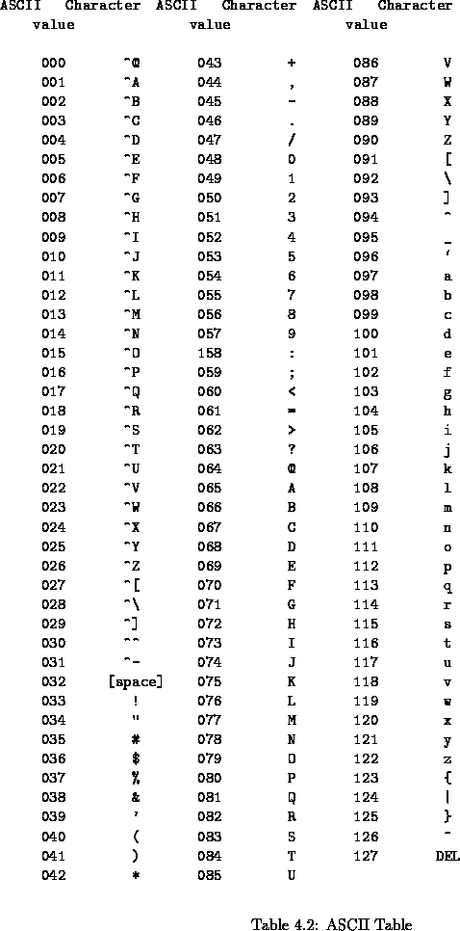

ASCII code
“American Standard Code for Information Interchange”
Limit of 7-bits
Limited to 127 characters
Other languages use more characters

Slide 61
Unicode
“Universal code”
8-, 16-, or 32-bits
Can use symbols, non-standard characters and even emojis

Slide 62
Exercises
If A=65 in ASCII code, what is 70?
What are two advantages of using Unicode?
Find the unicode equivalent for the following emojis:
🐙
🇩🇪
💩
🙃

Slide 63
Answers
If A=65 in ASCII code, what is 70? = E
What are two advantages of using Unicode?
Can represent a wider range of characters
Can represent characters from other languages
Can represent symbol and emojis
Find the unicode equivalent for the following emojis:
🐙 = U+1F419
🇩🇪 = U+1F1E9 U+1F1EA
💩 = U+1F4A9
🙃 = U+1F643
What is ASCII ABC in binary?

Slide 64
ILO’s
Understand character sets including ASCII and Unicode and the advantages of Unicode.
Be able to use a character table to convert a message from binary to a character set and vice-versa.

Slide 65

Images

Slide 66
ILO’s
Define key terms eg pixel, colour depth.
Calculate file sizes for bitmap images.
Convert between an image and binary and vice-versa.

Slide 67
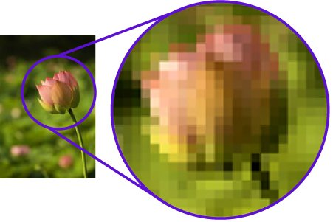
Bitmaps
Images are represented as bitmaps
Pixels make up bitmaps and store a variable number of bits
The more bits in a pixel the greater the variety of colour

Slide 68
Bitmaps
1-bit per pixel
0 | 0 | 0 | 0 | 0 | 0 | 0 | 0 | 0 | 0
0 | 0 | 1 | 1 | 0 | 0 | 1 | 1 | 0 | 0
0 | 0 | 1 | 1 | 0 | 0 | 1 | 1 | 0 | 0
0 | 0 | 0 | 0 | 0 | 0 | 0 | 0 | 0 | 0
0 | 0 | 0 | 0 | 0 | 0 | 0 | 0 | 0 | 0
0 | 0 | 1 | 1 | 1 | 1 | 1 | 1 | 0 | 0
0 | 0 | 0 | 0 | 0 | 0 | 0 | 0 | 0 | 0
0 | 0 | 0 | 0 | 0 | 0 | 0 | 0 | 0 | 0
Either black (1) or white (0)

Slide 69
Bitmaps
1-bit per pixel
Either black (1) or white (0)

Slide 70
Bitmaps
4-bit per pixel = hexadecimal
#FFFF00 | #FFFF00 | #FFFF00 | #FFFF00 | #FFFF00 | #FFFF00 | #FFFF00 | #FFFF00 | #FFFF00 | #FFFF00
#FFFF00 | #FFFF00 | #000000 | #000000 | #FFFF00 | #FFFF00 | #000000 | #000000 | #FFFF00 | #FFFF00
#FFFF00 | #FFFF00 | #000000 | #000000 | #FFFF00 | #FFFF00 | #000000 | #000000 | #FFFF00 | #FFFF00
#FFFF00 | #FFFF00 | #FFFF00 | #FFFF00 | #FFFF00 | #FFFF00 | #FFFF00 | #FFFF00 | #FFFF00 | #FFFF00
#FFFF00 | #FFFF00 | #000000 | #000000 | #000000 | #000000 | #00000 | #000000 | #FFFF00 | #FFFF00
#FFFF00 | #FFFF00 | #FFFF00 | #FFFF00 | #FFFF00 | #FFFF00 | #FFFF00 | #FFFF00 | #FFFF00 | #FFFF00
#FFFF00 | #FFFF00 | #FFFF00 | #FFFF00 | #FFFF00 | #FFFF00 | #FFFF00 | #FFFF00 | #FFFF00 | #FFFF00
#FFFF00 | #FFFF00 | #FFFF00 | #FFFF00 | #FFFF00 | #FFFF00 | #FFFF00 | #FFFF00 | #FFFF00 | #FFFF00

Slide 71
Bitmaps
4-bit per pixel = hexadecimal

Slide 72
Bitmaps
We can calculate image file sizes based on the number of pixels and bits
Where n is the number of bits per pixel
Size/bytes = width x height x (n/8)

Slide 73
Exercises
Draw a simple black and white design on a bitmap
See the faces as an example
Zoom into the pixels of three images and record how much you need to zoom into them to see the pixel level
Calculate the amount of storage needed for that image

Slide 74
Answers
Draw a simple black and white design on a bitmap
See the faces as an example
Zoom into the pixels of three images and record how much you need to zoom into them to see the pixel level
Calculate the amount of storage needed for that image - Size/bytes = width x height x (n/8)

Slide 75
ILO’s
Define key terms eg pixel, colour depth.
Calculate file sizes for bitmap images.
Convert between an image and binary and vice-versa.

Slide 76
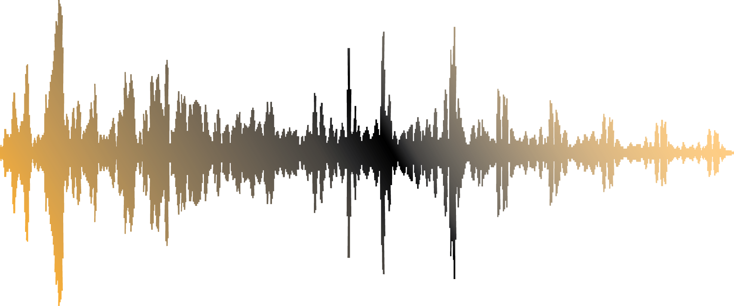
Sound

Slide 77
ILO’s
Understand the difference between analogue and digital.
Be able to recognise analogue and digital quantities.
Be able to explain how sample rate and sample resolution affect sample quality and file size.
Be able to calculate file sizes for sound files.

Slide 78

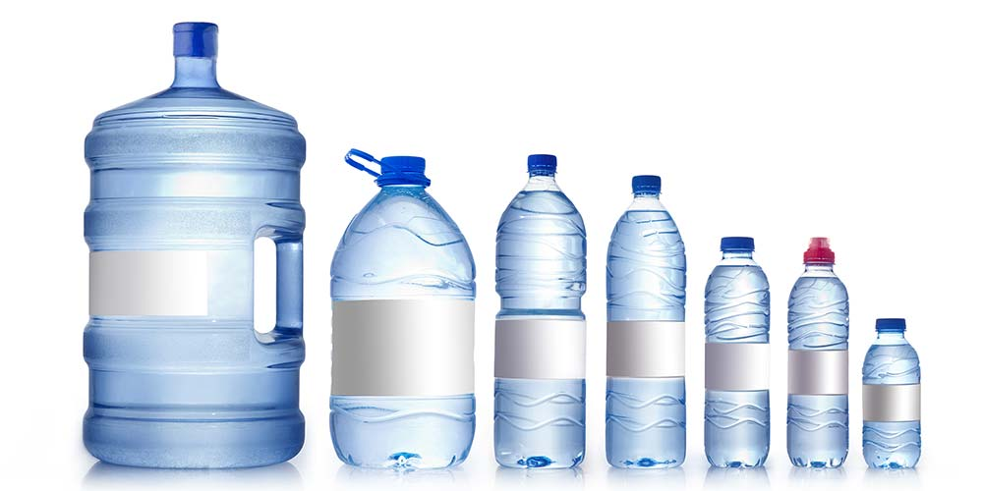
Analogue and digital
Analogue uses constantly changing “sound waves” to represent sound
Continuously changing amplitude
Can be interfered with
Continous values
Digital tries to capture this into standalone units (0/1)
Discrete values

Slide 79

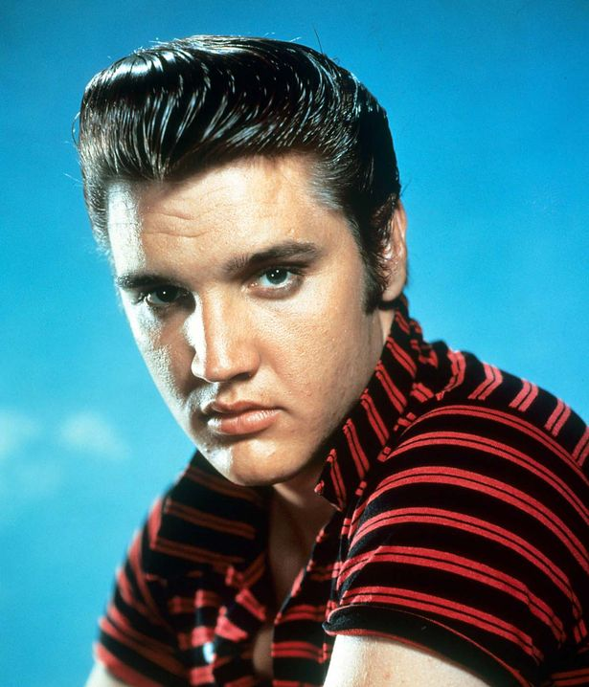
Analogue and digital
Digital is easy to copy and transfer
Convert analogue to digital via sampling, stores to bits
Snapshots of sound
Higher the sampling rate the better the sound quality
The number of bits we record per sample also improves quality
Sampling frequency is in hertz
File size /bytes = (sampling frequency * bit depth * length) / 8
https://www.youtube.com/watch?v=hRhVb6iRArg
https://www.youtube.com/watch?v=cp9tNW_g8p0

Slide 80
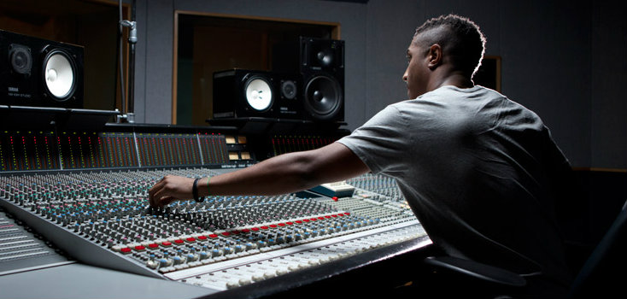
Exercises
Calculate the size of a twenty second long song that is recorded at 8000 hertz and a 16-bit depth
Describe why sound must be converted to digital format before it can be stored?
The sound engineer currently uses a sample resolution of 4 bits which enables a sample to be stored as one of 16 different bit patterns. She wants to increase the number of bit patterns available from 16 to 32. What is the minimum sample resolution (in bits) she can choose that will allow her to do this?
What are the effects of increasing the sampling rate?

Slide 81
Answers
Calculate the size of a twenty second long song that is recorded at 8000 hertz and a 16-bit depth - 320000 bytes
Describe why sound must be converted to digital format before it can be stored? Computers use binary, discrete, digital values, whereas sound is analogue/continuous
The sound engineer currently uses a sample resolution of 4 bits which enables a sample to be stored as one of 16 different bit patterns. She wants to increase the number of bit patterns available from 16 to 32. What is the minimum sample resolution (in bits) she can choose that will allow her to do this? – 5-bits
What are the effects of increasing the sampling rate? - Increased quality and file size

Slide 82
ILO’s
Understand the difference between analogue and digital.
Be able to recognise analogue and digital quantities.
Be able to explain how sample rate and sample resolution affect sample quality and file size.
Be able to calculate file sizes for sound files.

Slide 83
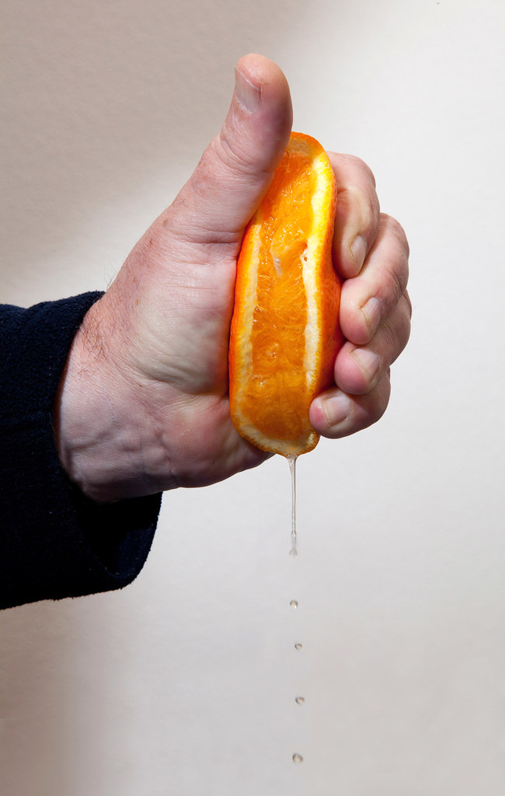
Data compression

Slide 84
ILO’s
Explain what data compression is, and why it’s used.
Be able to decompress data using Huffman coding and calculate how many bits are used compared to using uncompressed ASCII.
Be able to compress/decompress data using RLE.

Slide 85
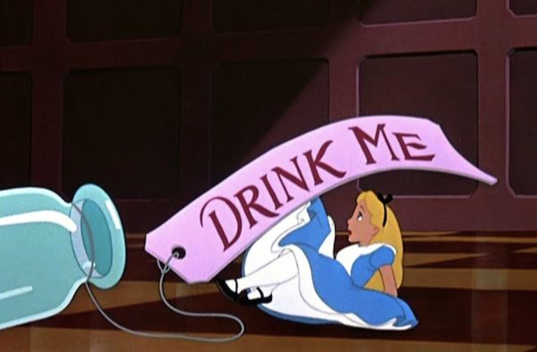
What is data compression?
We can’t physically squeeze “data”
Compression means encoding data to reduce the number of bits / file size
We see this a lot when switching between file formats
JPEG < PNG < TIFF

Slide 86
What is data compression?
We can’t physically squeeze “data”
Compression means encoding data to reduce the number of bits / file size
We see this a lot when switching between file formats
JPEG < PNG < TIFF
Why do we use compression?

Slide 87


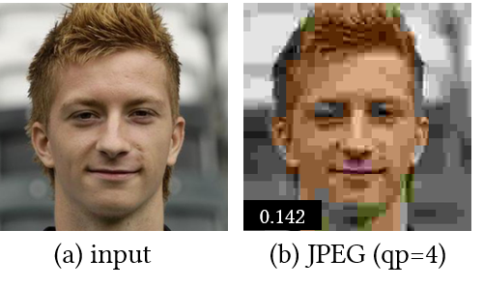
Types of compression
Lossless compression
No information is lost when you decompress
Example: zip compression
Lossy compression
Discard some information, much higher compression rate
Irreversible
Example: jpeg compression

Slide 88
Run Length Encoding (RLE)
Simple lossless compression algorithm
Works well with repetitive data

Slide 89
Run Length Encoding (RLE)
Simple lossless compression algorithm
Works well with repetitive data
Replace runs of characters with a single character and followed the repeat length
Compression rate = 13-10 / 13 x 100 = 3/13 x 100 = 23%
A | A | A | A | B | B | B | C | C | B | B | A | A
13 bytes
A | 4 | B | 3 | C | 2 | B | 2 | A | 2
10 bytes

Slide 90
Run Length Encoding (RLE)
How would this work for an image?

Slide 91
Run Length Encoding (RLE)
How would this work for an image?

Slide 92
Run Length Encoding (RLE)
How would this work for an image?
0 | 3

Slide 93
Run Length Encoding (RLE)
How would this work for an image?
0 | 3 | 1 | 1

Slide 94
Run Length Encoding (RLE)
How would this work for an image?
0 | 3 | 1 | 1 | 0 | 3

Slide 95
Run Length Encoding (RLE)
How would this work for an image?
0 | 3 | 1 | 1 | 0 | 3
0 | 3 | 1 | 1 | 0 | 3
0 | 3 | 1 | 1 | 0 | 3

Slide 96
Run Length Encoding (RLE)
How would this work for an image?
0 | 3 | 1 | 1 | 0 | 3
0 | 3 | 1 | 1 | 0 | 3
0 | 3 | 1 | 1 | 0 | 3
1 | 7

Slide 97
Run Length Encoding (RLE)
How would this work for an image?
0 | 3 | 1 | 1 | 0 | 3
0 | 3 | 1 | 1 | 0 | 3
0 | 3 | 1 | 1 | 0 | 3
1 | 7
0 | 3 | 1 | 1 | 0 | 3
0 | 3 | 1 | 1 | 0 | 3
0 | 3 | 1 | 1 | 0 | 3

Slide 98
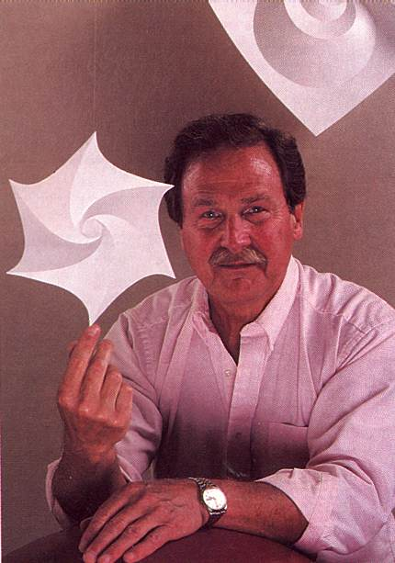
Huffman encoding
Bit more complicated…

Slide 99
Huffman encoding
7-bit * 22 chars = 154 bits
Let’s encode the phrase “NAUGHTY ORANGE OCTOPUS”

Slide 100
Huffman encoding
Let’s encode the phrase “NAUGHTY ORANGE OCTOPUS”
We must calculate the frequencies of each letter

Slide 101
Huffman encoding
Let’s encode the phrase “NAUGHTY ORANGE OCTOPUS”
We must calculate the frequencies of each letter

Slide 102
Huffman encoding
Space | 2
N | 2
A | 2
U | 2
G | 2
H | 1
T | 2
Y | 1
O | 3
R | 1
E | 1
C | 1
P | 1
S | 1

Slide 103
Huffman encoding
Let’s encode the phrase “NAUGHTY ORANGE OCTOPUS”
We must calculate the frequencies of each letter
Order the letters from highest to lowest

Slide 104
Huffman encoding
Space | 2
N | 2
A | 2
U | 2
G | 2
H | 1
T | 2
Y | 1
O | 3
R | 1
E | 1
C | 1
P | 1
S | 1
O | 3
Space | 2
N | 2
A | 2
U | 2
G | 2
T | 2
H | 1
Y | 1
R | 1
E | 1
C | 1
P | 1
S | 1

Slide 105
Huffman encoding
Let’s encode the phrase “NAUGHTY ORANGE OCTOPUS”
We must calculate the frequencies of each letter
Order the letters from highest to lowest
Now comes the example….

Slide 106
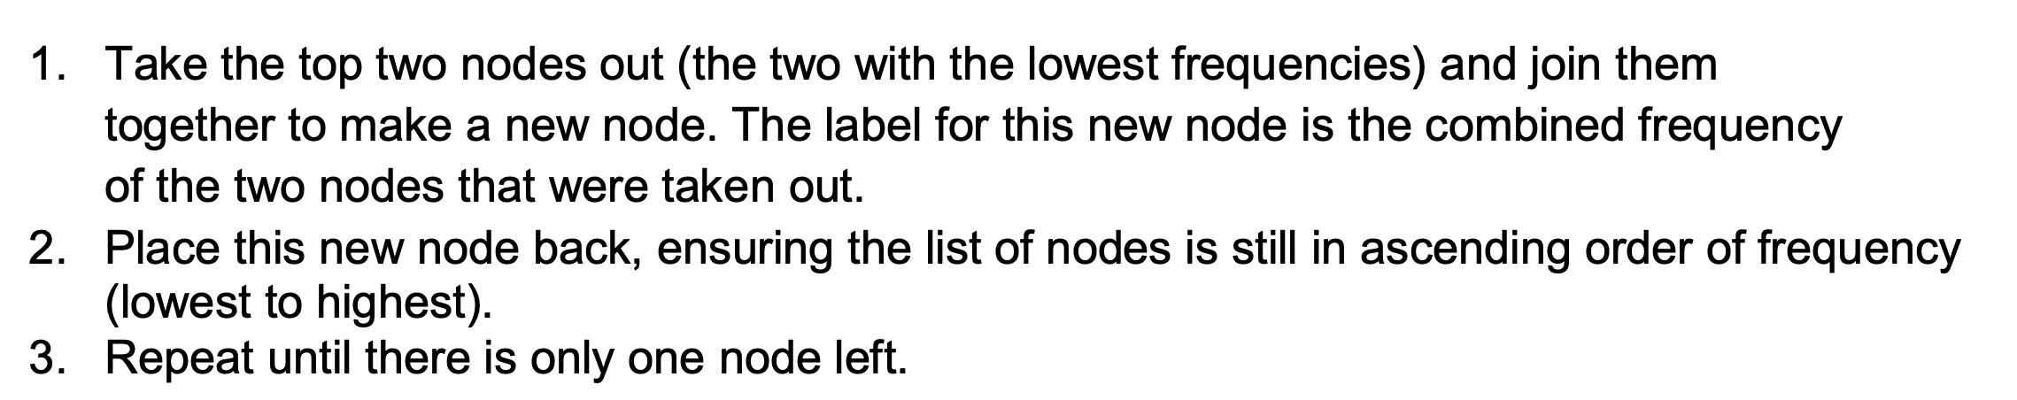
Huffman encoding
Let’s encode the phrase “NAUGHTY ORANGE OCTOPUS”
We must calculate the frequencies of each letter
Order the letters from highest to lowest
Definition of remaining algorithm

Slide 107
Huffman encoding
Let’s encode the phrase “NAUGHTY ORANGE OCTOPUS”
We must calculate the frequencies of each letter
Order the letters from highest to lowest
Definition of remaining algorithm
Then add binary values…

Slide 108
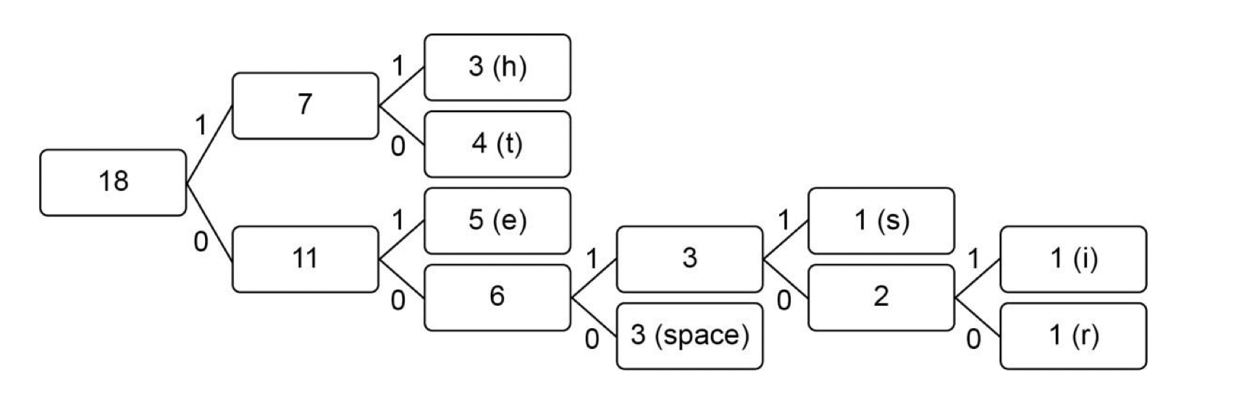
Huffman encoding

Slide 109
Huffman encoding
Let’s encode the phrase “NAUGHTY ORANGE OCTOPUS”
We must calculate the frequencies of each letter
Order the letters from highest to lowest
Definition of remaining algorithm
Then add binary values…
How many bits is the phrase?

Slide 110
Exercises
Perform RLE on the phrase “he ties the tether”
Perform Huffman coding on the phrase “he ties the tether”
Calculate the compression rate of Huffman coding on the “he ties the tether” phrase

Slide 111
Answers
Perform RLE on the phrase “he ties the tether”
H1E1space1T1I1E1S1space1T1H1HE1space1T1E1T1H1E1R1
Perform Huffman coding on the phrase “he ties the tether”
Calculate the compression rate of Huffman coding on the “he ties the tether” phrase – see following slide

Slide 112
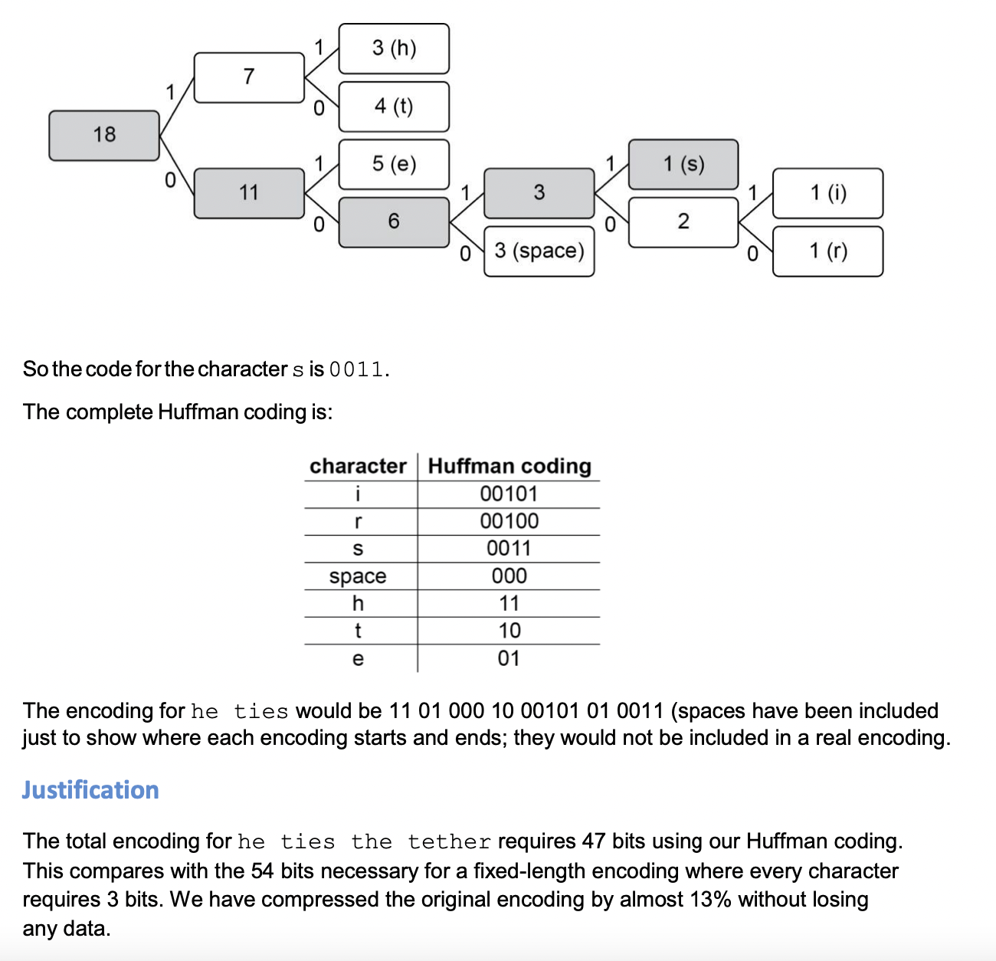
Exercises

Slide 113
ILO’s
Explain what data compression is, and why it’s used.
Be able to decompress data using Huffman coding and calculate how many bits are used compared to using uncompressed ASCII.
Be able to compress/decompress data using RLE.

